Slide 1
Predicting Impact of Road Accidents on Traffic Flow
Tsu-Hao Fu
Koushiki Basu
Yohan Berg
Gopireddy Avinash Reddy

Slide 2
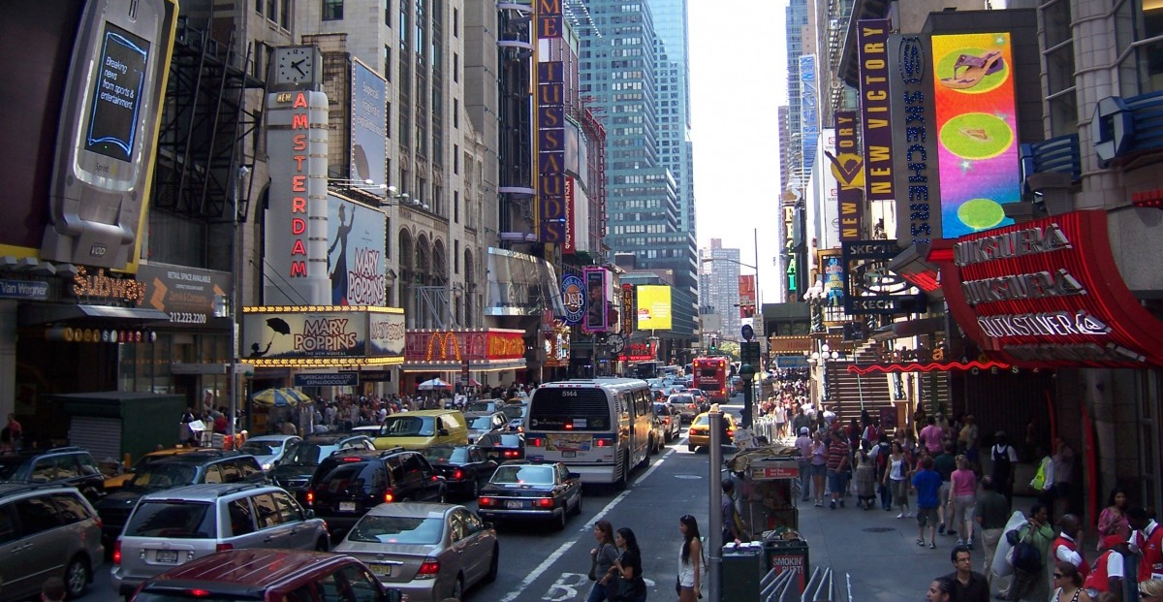
Problem Introduction
Source: https://pxhere.com/en/photo/694335
Notes:
We can refit our proposal’s introduction here. Maybe just a couple slides of visuals?
yohan

Slide 3
Average Annual Delay per Commuter
27 hrs
54 hrs
46
hrs
119 hrs
2020
US Average
2021
US Average
2020
LA, Long Beach - Anaheim, CA
2021
LA, Long Beach - Anaheim, CA
David Schrank, Luke Albert, Bill Eisele, Tim Lomax. "2021 Urban Mobility Report and Appendices." The Texas A&M Transportation Institute, 2021.
Notes:
yohan

Slide 4
Average Annual Delay per Commuter
27 hrs
54 hrs
46
hrs
119 hrs
A large cause for traffic delays are traffic accidents!
Zeng J, Qian Y, Wang B, Wang T, Wei X. The Impact of Traffic Crashes on Urban Network Traffic Flow. Sustainability. 2019; 11(14):3956. https://doi.org/10.3390/su11143956
2020
US Average
2021
US Average
2020
LA, Long Beach - Anaheim, CA
2021
LA, Long Beach - Anaheim, CA
David Schrank, Luke Albert, Bill Eisele, Tim Lomax. "2021 Urban Mobility Report and Appendices." The Texas A&M Transportation Institute, 2021.
Notes:
yohan

Slide 5
Our Project Goal
Traffic-Flow Analysis is difficult because of Large, Complex Data impacted with Noise and Real-Time changes in conditions.
Analyze several data mining technique and algorithms
Create performant models on the data
Identify the models’ distinct advantages and drawbacks
Notes:
Talk about the challenges of the dataset, then introduce our research topic.
yohan

Slide 6
Dataset
Dataset Used: US Accidents data available on Kaggle, a country-wide dataset of traffic accidents combining multiple APIs such as "MapQuest Traffic" and "Microsoft Bing Map Traffic."
7.7 million entries
46 total attributes
Target attribute is accident severity (measures traffic flow impact)
Table1. Details of attributes
Traffic Attributes | ID, source, severity, start_time, end_time, start_lattitude, end_lattitude, start_longitude, end_longitude, distance, and description
Address Attributes | street, city, county, state, zip-code, country, timezone, and airport_code
Weather Attributes | time, temperature, wind_chill, humidity, pressure, visibility, wind_direction, wind_speed, precipitation, and condition (e.g., rain, snow, etc.)
POI Attributes | amenity, bump, crossing, give-way, junction, no-exit, railway, roundabout, station, stop, traffic calming, traffic signal, and turning loop
Period-of-Day | Sunrise/Sunset, Civil Twilight, Nautical Twilight, and Astronomical Twilight
Moosavi, Sobhan, Mohammad Hossein Samavatian, Srinivasan Parthasarathy, and Rajiv Ramnath. "A Countrywide Traffic Accident Dataset.", 2019.
Koushiki Basu

Slide 7
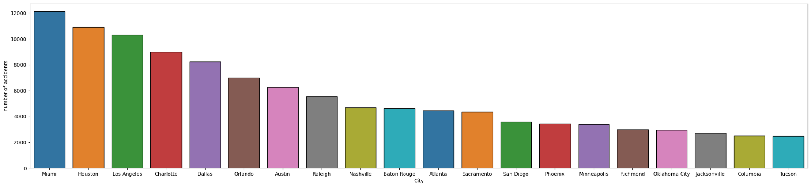
Data Visualization
Koushiki Basu

Slide 8
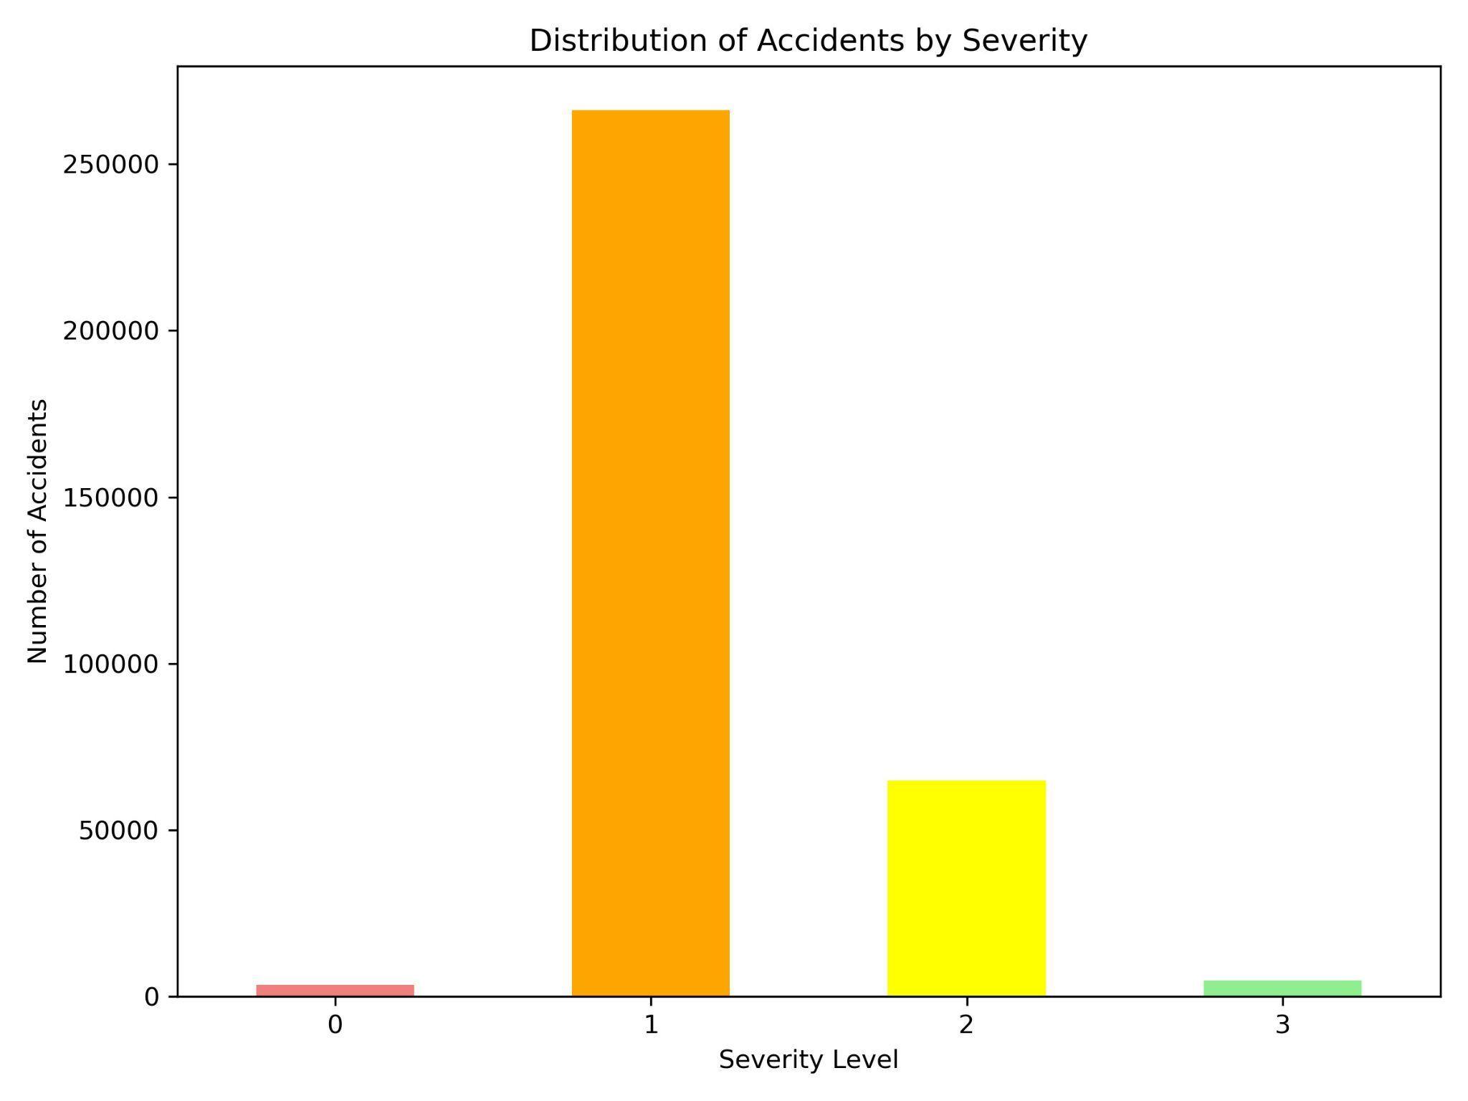
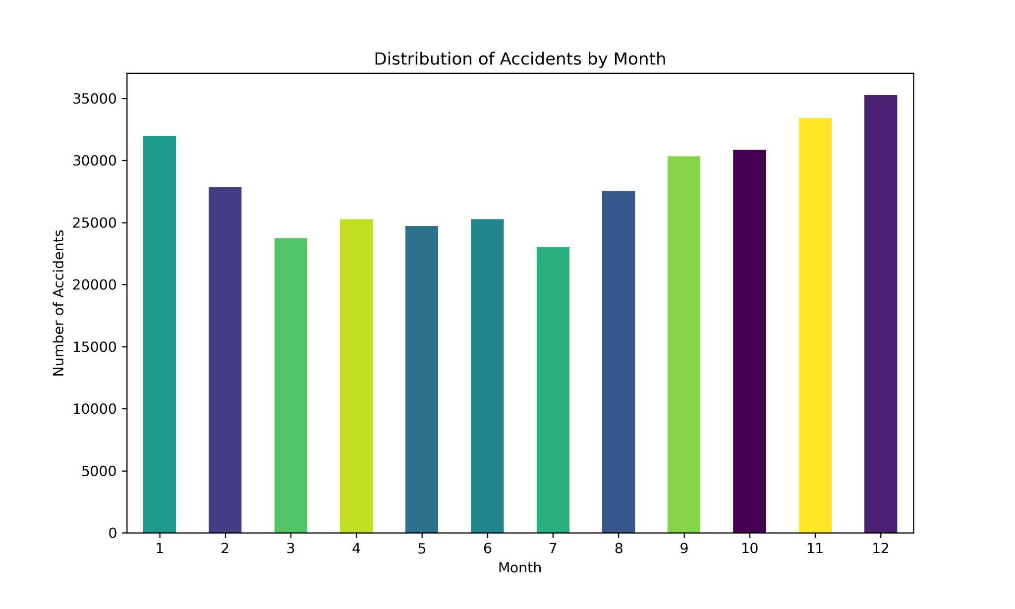
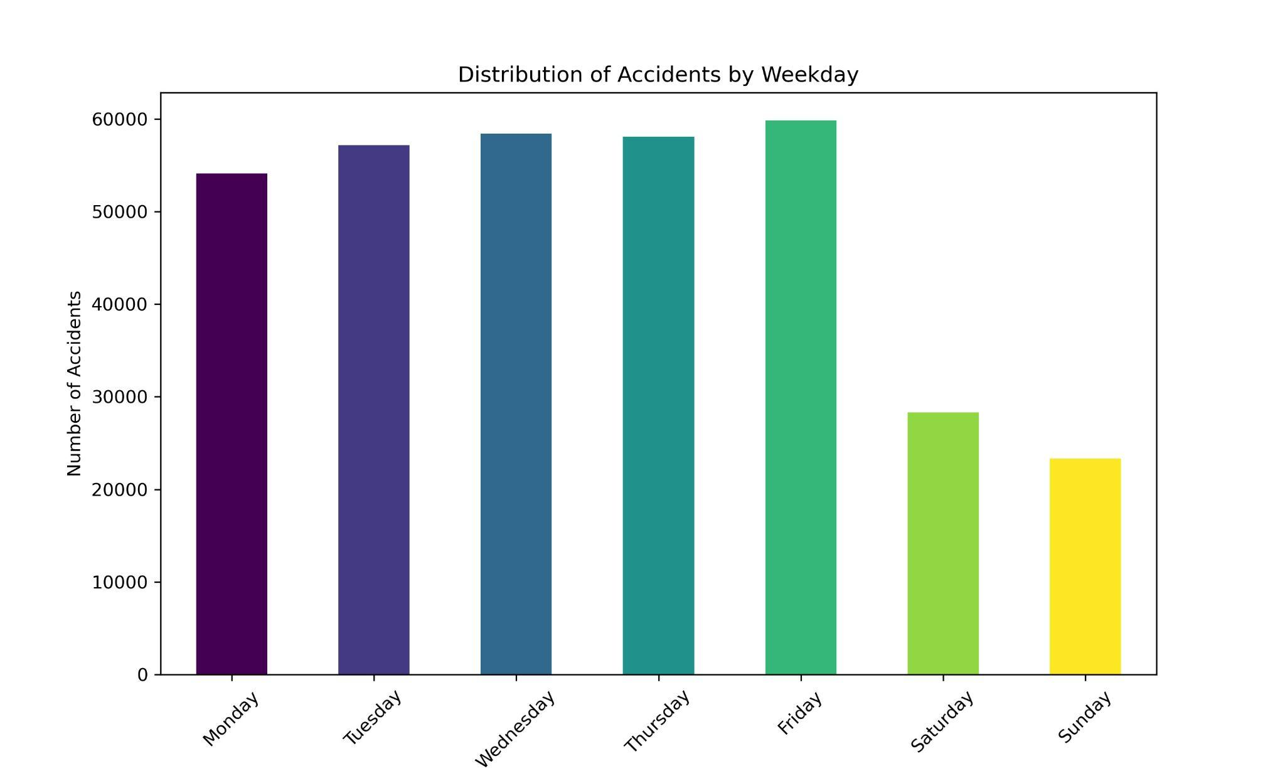
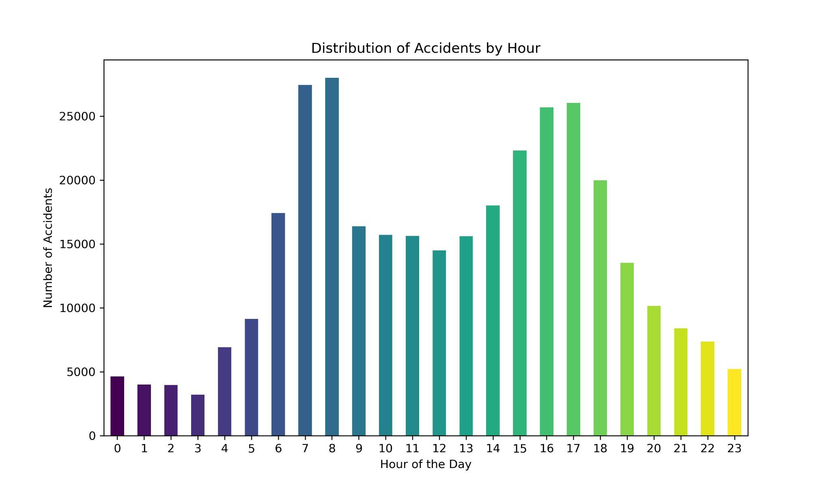
Koushiki Basu

Slide 9
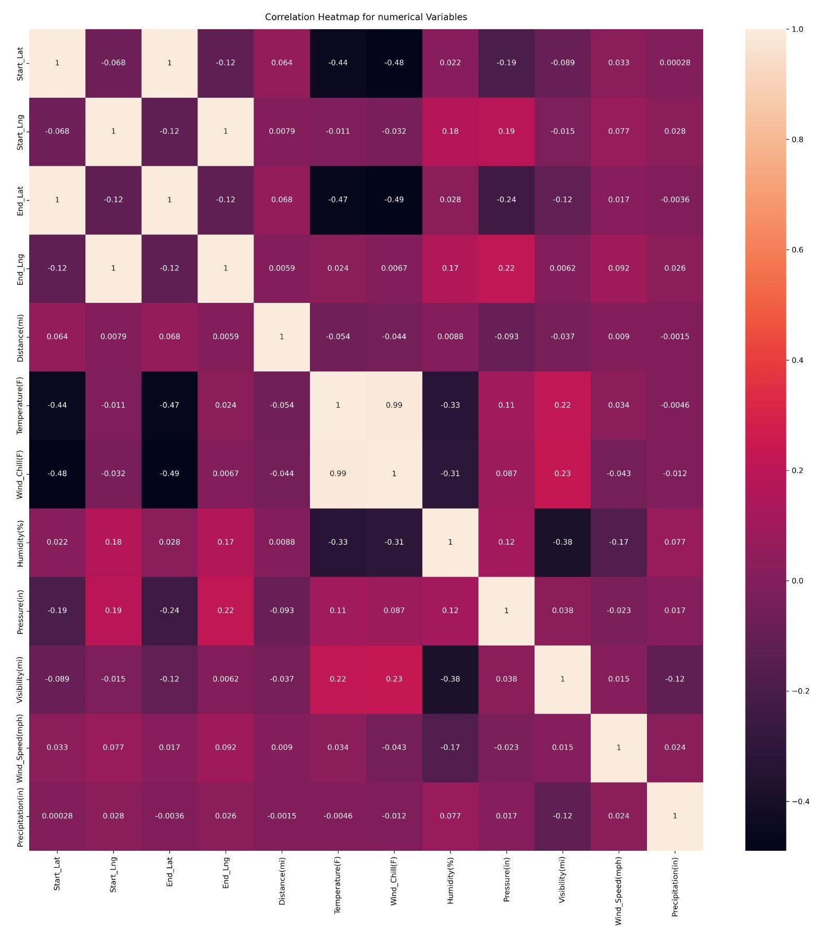
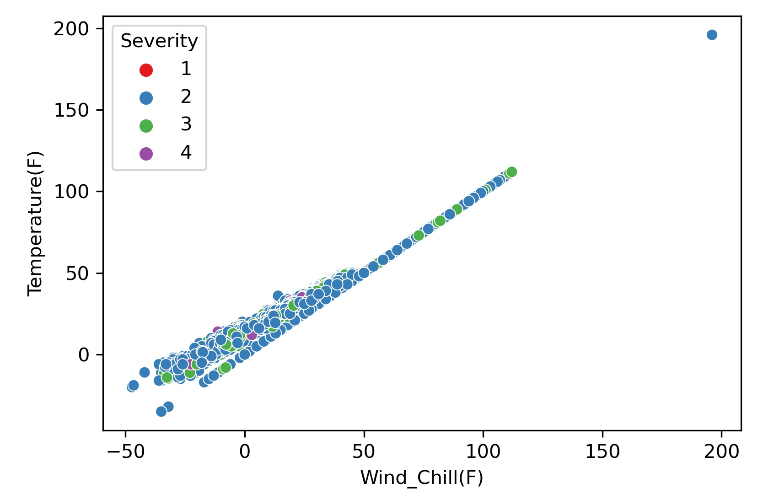

Slide 10
EDA - Data Preprocessing
Handling Missing Values: High-missing-rate data like "End Lat" and "End Lng" are removed. Other missing values are either dropped or replaced with similar data or common values based on certain groupings.
Outlier Detection and Handling: Outliers are identified using a specific method and are processed or adjusted to make the data more uniform.
Standardization: Numerical data is adjusted to standard scales (mean of 0 and standard deviation of 1), which is important for some machine learning models to perform well.
Notes:
Handling Missing Values: For missing data, variables with a high missing rate like "End Lat" and "End Lng" are discarded. Missing values in essential features are managed by dropping them outright or replacing them with correlated values or statistical imputations (e.g., using median or mode based on grouping by 'Airport Code' and 'Month').
Outlier Detection and Handling: Outliers, which are data points that deviate significantly from other observations, are identified using the interquartile range (IQR) method. After detection, outliers in numerical columns like 'Distance(mi)' and 'Temperature(F)' are processed to normalize the data.
Standardization: Numerical data is standardized to have a mean of 0 and a standard deviation of 1, which is crucial for models that depend on the magnitude of variables, such as SVMs and KNN. This standardization applies to variables like 'Accident Duration(min)', 'Distance(mi)', and 'Temperature(F)', among others, to ensure consistency and improve model performance.

Slide 11
EDA - Feature Engineering
Binning: Groups complex variables like Wind direction and Weather conditions into simpler categories (e.g., weather into sunny, cloudy, rain; wind direction into north, east, south, west).
Time Extraction: Breaks down detailed DateTime information into easier-to-understand parts like Year, Month, Day, and Hour. It also creates a new feature, "Accident Duration," from the accident start and end times.
Label Encoding: Converts categorical data into numbers by assigning each category a unique integer, making the data suitable for machine learning models.
Frequency Encoding: Replaces categories with the frequency of their occurrence in the dataset, which helps retain the importance of more common categories.
Notes:
Binning: To simplify the complexity, variables like Wind direction and Weather conditions are categorized into broader groups. For example, Weather conditions are divided into categories like sunny, cloudy, rain, etc., and Wind direction is categorized as north, east, south, west, etc.
Time Extraction: Detailed DateTime information is broken down into simpler components like Year, Month, Day, Weekday, and Hour for better usability in models. Additional features such as "Accident Duration" are derived from start and end times, with some less relevant timestamps being excluded from analysis.
Label Encoding: This technique is used to transform categorical data into numerical format by assigning a unique integer to each category, making it understandable for machine learning algorithms. It's applied to various categorical variables including 'State', 'Timezone', and 'Weather Condition'.
Frequency Encoding: Categorical variables are encoded by replacing each category with its frequency of occurrence in the dataset. This helps in maintaining the significance of a category based on its prevalence and is applied to variables with a large number of unique values like 'Street' and 'City'.

Slide 12
Model Evaluation
We used the below evaluation metrics for the models:
Macro Average of F1 Score
Accuracy
Precision
Recall
F1 Score
Confusion Matrix

Slide 13
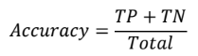
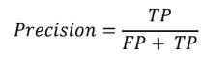
Model Evaluation
Accuracy is the ratio of correctly classified instances out of the total instances.
Precision is the ratio of true positive predictions among all positive predictions made by the model.

Slide 14
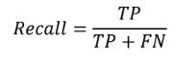
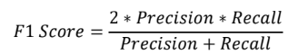
Model Evaluation
Recall (also called sensitivity or true positive rate) is the ratio of true positive predictions among all actual positive instances in the dataset.
F1 Score is the harmonic mean of precision and recall. It provides a balance between precision and recall.

Slide 15
Logistic Regression
Introduction to Logistic Regression
Logistic regression model estimates the probability that a given input belongs to a particular class.
Primarily used for binary classification problems, but it can be extended to handle multi-class classification as well.
It uses a strategy called "one-vs-rest" to handle multi-class classification.
Each class is treated as a binary classification problem, and a separate logistic regression model is trained for each class.

Slide 16
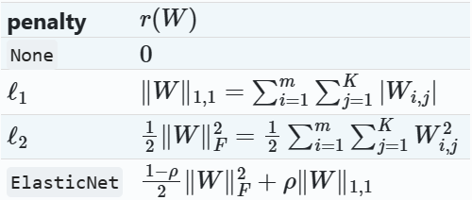
Logistic Regression
Training Logistic Regression Models
We used the following for the regularization term r(W) via the penalty argument, where m is the number of features:
Source: https://scikit-learn.org/stable/modules/linear_model.html#logistic-regression

Slide 17
Logistic Regression
Training Logistic Regression Models
▪ We trained the logistic regression model with the following solvers:
lbfgs
newton-cg
sag
saga

Slide 18
Logistic Regression
Training Logistic Regression Models
The “lbfgs”, “newton-cg” and “sag” solvers only support l2
regularization.
The “sag” solver uses Stochastic Average Gradient descent.
The “saga” solver is a variant of “sag” that also supports the non-smooth penalty="l1". It is also the only solver that supports penalty="elasticnet".
The “lbfgs” is an optimization algorithm that approximates the Limited-memory Broyden–Fletcher–Goldfarb–Shanno algorithm, which belongs to quasi-Newton methods.
Source: https://scikit-learn.org/stable/modules/linear_model.html#logistic-regression

Slide 19
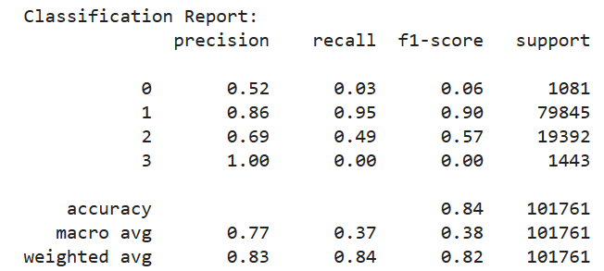
Logistic Regression
Classification report for Logistic regression:

Slide 20
SGDClassifier
Linear classifiers (SVM, logistic regression, etc.) with SGD training.
This estimator implements regularized linear models with stochastic gradient descent (SGD) learning.
The gradient of the loss is estimated each sample at a time and the model is updated along the way with a decreasing strength schedule (i.e., learning rate).
Source: https://scikit-learn.org/stable/modules/generated/sklearn.linear_model.SGDClassifier.html#sklearn.linear_model.SGDClassifier

Slide 21
SGDClassifier
We used the ‘loss’ parameter to select the loss function to be used.
‘hinge’ gives a linear SVM.
‘log_loss’ gives logistic regression, a probabilistic classifier.
We used the default penalty (l2) in the modelling.
The learning rate used is ‘optimal’.
‘optimal’: eta = 1.0 / (alpha * (t + t0)) where t0 is chosen by a heuristic proposed by Leon Bottou.
Number of iterations with no improvement to wait before stopping fitting, ‘n_iter_no_change’ =5.
Source: https://scikit-learn.org/stable/modules/generated/sklearn.linear_model.SGDClassifier.html#sklearn.linear_model.SGDClassifier

Slide 22
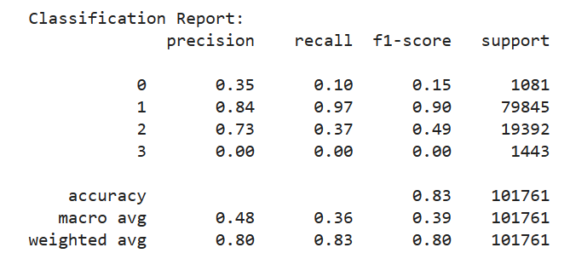
SGDClassifier
Classification report for SGDClassifier with loss = ‘hinge’

Slide 23
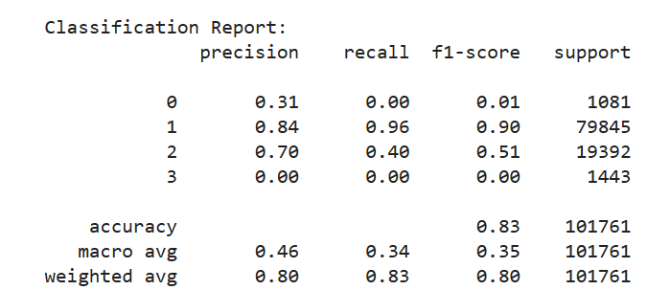
SGDClassifier
Classification report for SGDClassifier with loss = ‘log_loss’

Slide 24
KNeighborsClassifier
Neighbors-based classification is a type of instance-based learning.
Classification is computed from a simple majority vote of the nearest neighbors of each point.
A query point is assigned the data class which has the most representatives within the nearest neighbors of the point.
KNeighborsClassifier implements learning based on the k nearest neighbors of each query point, where k is an integer value specified by the user.
Source: https://scikit-learn.org/stable/modules/neighbors.html#nearest-neighbors-classification

Slide 25
KNeighborsClassifier
Macro Average of F1 score for KNeighborsClassifier:
The optimal choice of the value k is highly data-dependent.
We used k = 5, 10, 15, 20 for our model.
k | Macro Average
5 | 0.39
10 | 0.35
15 | 0.34
20 | 0.33

Slide 26
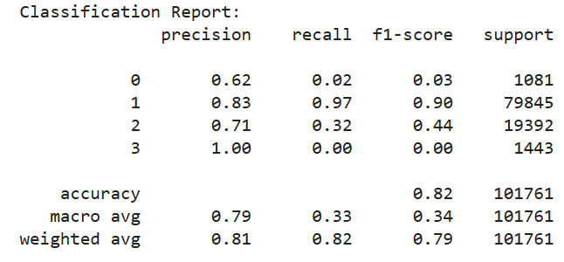
KNeighborsClassifier
Classification report for KNeighborsClassifier, k=15:

Slide 27
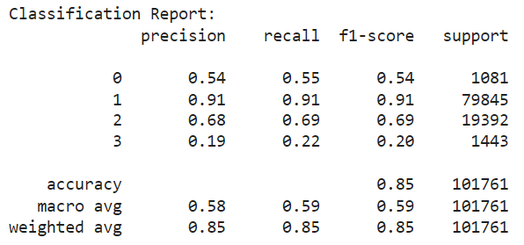
Decision Trees
Decision trees efficiently capture intricate relationships between features and target variables, enabling interpretable models with robust performance in noisy datasets.
Their innate ability to partition the feature space and focus on informative features allows them to represent complex decision boundaries and handle both numerical and categorical data effectively.
Koushiki Basu

Slide 28
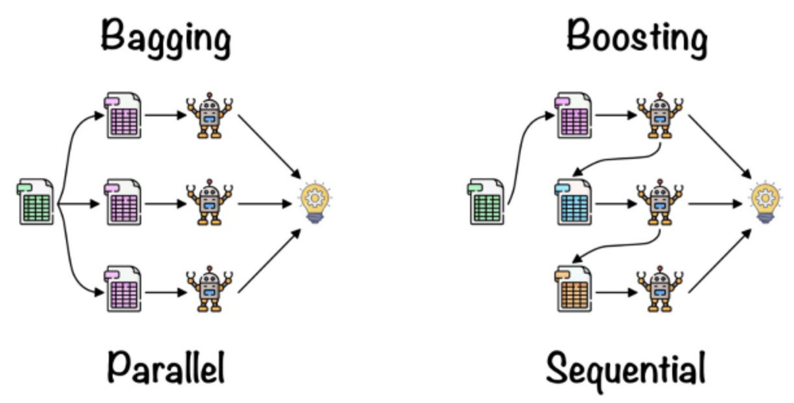
Ensemble Learning
https://www.kaggle.com/code/faridaelhusseinyy/ml-project-final#Auto-ML
Notes:
Ensemble learning synthesizes multiple-base learners through
certain combination strategies to obtain the final result. Ac-
cording to the way of ensemble, ensemble learning can be
divided into parallel integration (Bagging) and serial integra-
tion (Boosting).

Slide 29
Bagging
Parallel training: distribute the training of individual base models across multiple computing resources and enable simultaneous independent model training on different subsets of the data
Variance Reduction: Training several models on distinct data subsets yields an ensemble prediction that is more stable and less prone to overfitting.
Robustness: enhances robustness by combining predictions from varied models, rendering the ensemble less susceptible to outliers and noisy data points.
Model Agnosticism: utilized with any foundational learning algorithm, making it a flexible technique capable of improving the efficacy of a range of machine learning models (decision trees, neural networks, and support vector machines).
Koushiki Basu

Slide 30
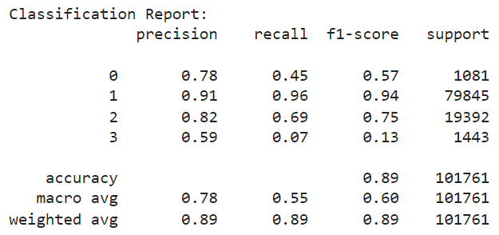
Bagging - Random Forest
mitigate overfitting and improve generalization by aggregating predictions from multiple decision trees, offering high accuracy and robustness across diverse datasets
ensemble approach, coupled with bagging and random feature selection, enhances model stability, scalability, and interpretability, making it suitable for handling high-dimensional data, and noisy environments.
Koushiki Basu

Slide 31
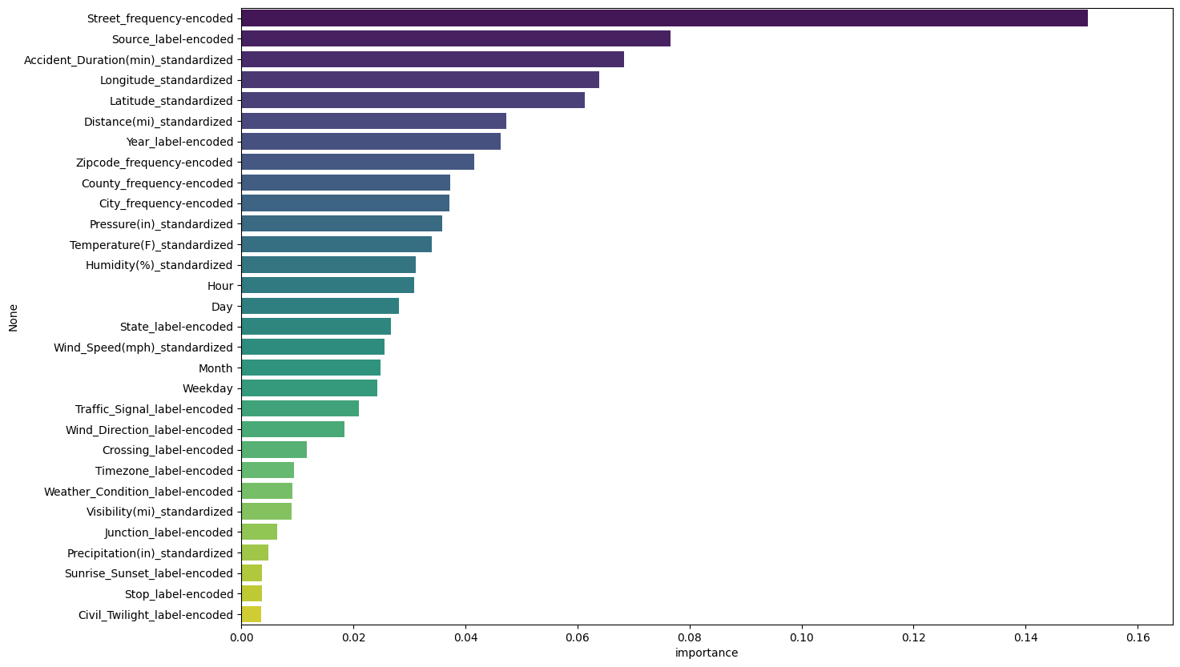
Bagging - Random Forest
Koushiki Basu

Slide 32
Boosting
Sequential Training: Each model is trained one after the other, learning specifically from the mistakes of the model before it.
Error Focus: The training focuses on instances that were previously incorrect, adjusting their importance in the next model.
Reduces Bias and Variance: Boosting starts with simple assumptions and gradually becomes more complex to improve prediction accuracy and reduce errors.
Shallow Trees for Interpretability: Unlike in bagging techniques like Random Forest where trees are fully grown, boosting uses shallow trees (trees with fewer splits), which enhances their interpretability.

Slide 33
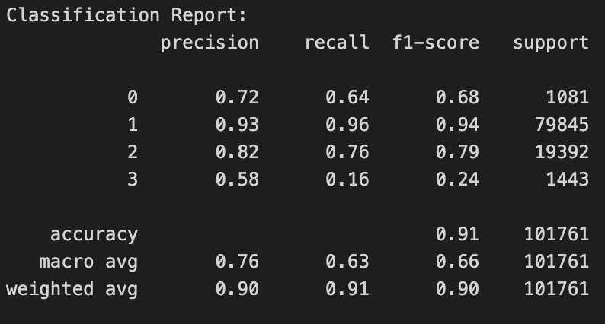
Boosting - XGBoost
eXtreme Gradient Boosting enhances traditional gradient boosting methods by incorporating regularization to prevent overfitting, improving its generalization capabilities.

Slide 34

Boosting - LightGBM
Light Gradient Boosting Machine optimizes performance through innovative techniques like Gradient-based One-Side Sampling (GOSS)
and Exclusive Feature Bundling (EFB), which stream-
line data processing and reduce dimensionality.

Slide 35
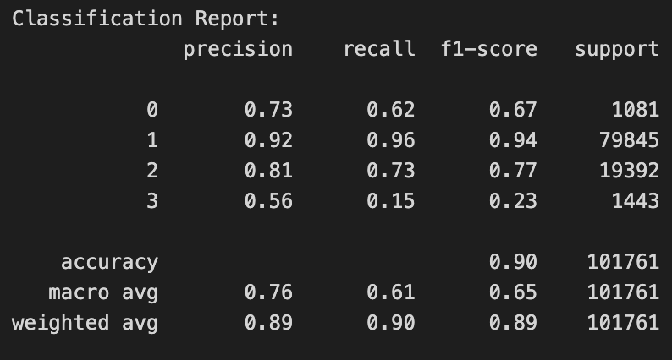
Boosting - CatBoost
CatBoost employs ordered boosting, a permutation-driven alternative to the classic gradient boosting method,which significantly reduces overfitting and improves the model’s accuracy.

Slide 36
Neural Networks
By combining many perceptrons, Neural Networks can learn non-linear patterns among the features for many tasks, including classification.
Expressive: Deep Neural Networks can learn very complex patterns in data. This can help the model learn feature relationships that other models may miss, but can also cause the model to easily overfit.
Regularization: Several techniques exist to help Neural Networks combat overfitting. Of these, Batch Normalization and Dropout were employed to allow the Neural Network to train longer without underperforming on test datasets.
Sensitive to Imbalanced Data: Neural Networks are sensitive to imbalanced data which is present in our dataset. We will see the effects of this in the results section.

Slide 37
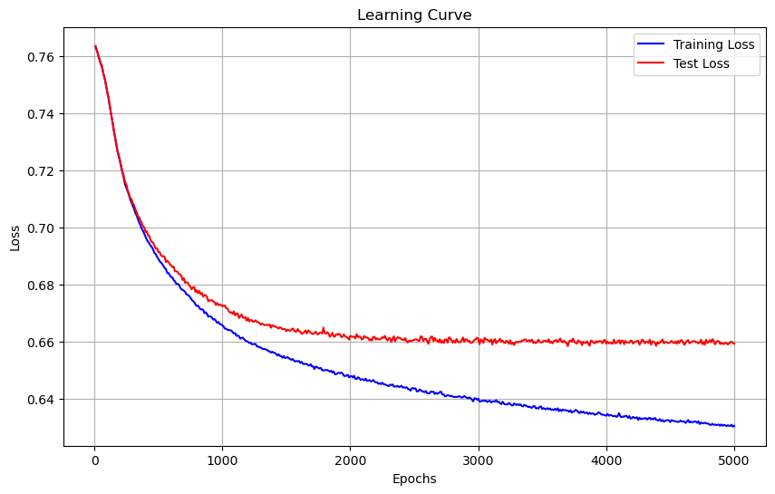
Neural Networks - Model
2 Hidden Layers of size 128 and 64
ReLU Activation function & Softmax output activation function
Batchnorm and Dropout after each hidden layer for regularization.
Trained separately on full dataset and resampled dataset.

Slide 38
Batch Normalization and Dropout
Batch Normalization
Neural Network tend to perform better on normalized data.
A technique implemented as a layer that helps normalize the hidden layers while speeding up training.
Dropout
Sometimes, neurons can learn spurious patterns in the data called “conspiracies” that cause overfitting.
By randomly disabling neurons during learning, the model cannot rely on “conspiracies” and must learn stable and general patterns.
Doshi, K. (2021, May 29). Batch norm explained visually - how it works, and Why Neural Networks Need it. Medium.
Ryanholbrook. (2023, April 20). Dropout and batch normalization. Kaggle.

Slide 39
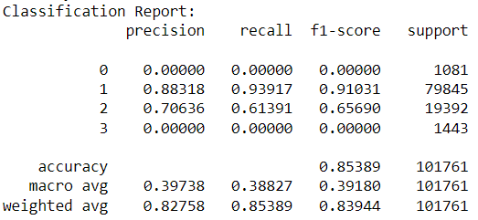
Neural Networks - Results
The Neural Network struggles to learn highly imbalanced data.

Slide 40
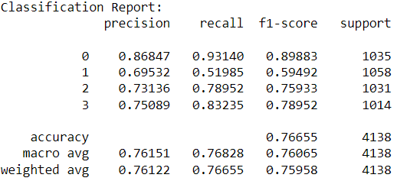
Neural Networks - Results cont’d

Slide 41
Imbalance Learning
Resampling Techniques: Adjust the number of samples from each class by either increasing the number of minority class samples or decreasing the number of majority class samples to balance the dataset.
Synthetic Data Generation: Create new, artificial samples to add to the minority class using algorithms like SMOTE, helping to balance the dataset without just copying existing samples.
Cost-sensitive Learning: Adjust the algorithm to penalize misclassifying the minority class more heavily than the majority class, encouraging better accuracy for the minority class.
Ensemble Methods: Build multiple models on different balanced subsets of the data, then combine their outputs to get a more fair and balanced result.
Notes:
Imbalanced learning techniques are used to address challenges in datasets where some classes are significantly more frequent than others. Here are four common approaches:
Resampling Techniques: These methods adjust the class distribution of a dataset by either oversampling the minority class (increasing its presence) or undersampling the majority class (reducing its presence). The goal is to create a more balanced dataset which can lead to better model performance on minority classes.
Synthetic Data Generation: Techniques like SMOTE (Synthetic Minority Over-sampling Technique) create synthetic examples rather than just replicating existing ones. This helps in adding diversity to the training data, thereby providing the models with a richer, more balanced dataset.
Cost-sensitive Learning: This approach modifies learning algorithms to make the cost of misclassifying minority class examples higher than those of the majority class. It adjusts the classification threshold by assigning higher misclassification costs to the minority class.
Ensemble Methods: Techniques such as Balanced Random Forests and EasyEnsemble involve creating multiple models (like decision trees in the case of Random Forests), each trained on a balanced dataset derived from the original, imbalanced dataset. These models are then aggregated to provide a balanced perspective on the data.

Slide 42
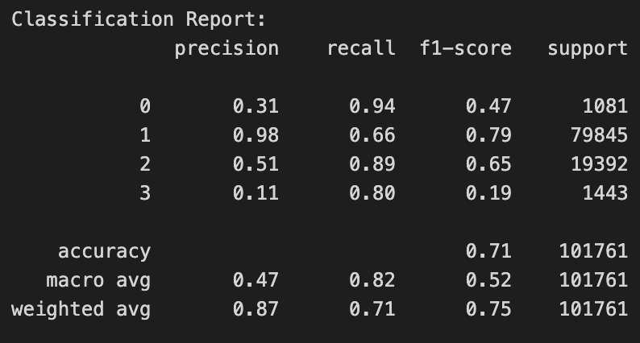
Imbalance Learning - SPE
The Self-paced Ensemble (SPE) technique adjusts the importance of difficult examples during training, gradually focusing more on them. It starts with simple cases and increasingly handles more complex ones, improving its accuracy over time.

Slide 43
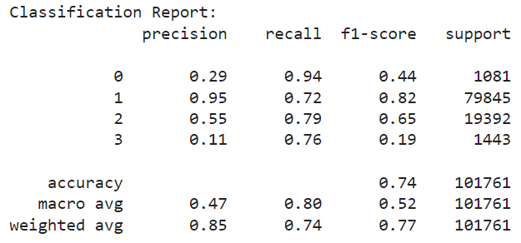
Imbalance Learning - Balanced Bagging
Balanced Bagging Classifier address class imbalance by employing balanced sampling strategies during model training, ensuring that minority classes receive adequate representation and preventing bias towards dominant classes

Slide 44
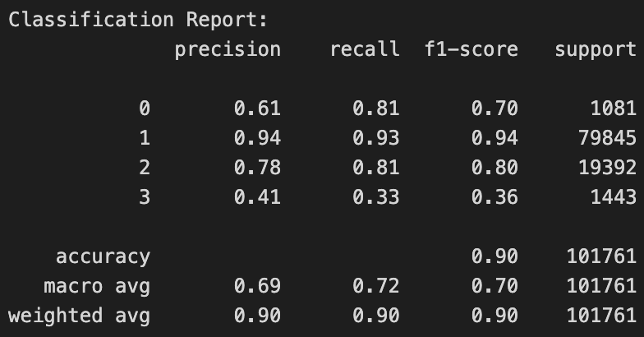
Voting
The Voting Classifier combines the predictions from the best models we got from the Ensemble Learning (Random Forest + XGBoost + LightGBM) and Imbalanced Learning (SPE + Balanced Bagging).
It predicts the class that receives the majority of votes from the combined models.

Slide 45
Results Comparison
Model | Accuracy | Macro Average of F1 score
Logistic Regression | 0.84 | 0.38
SGD Classifier | 0.83 | 0.39
KNN | 0.81 | 0.39
Decision Trees | 0.85 | 0.59
Bagging - Random Forest | 0.89 | 0.60
Boosting - XGBoost | 0.91 | 0.66
Boosting - LightGBM | 0.90 | 0.65
Boosting - CatBoost | 0.90 | 0.65
Deep Neural Network | 0.85 | 0.39
Imblearn - Self-Paced Ensemble | 0.71 | 0.52
Imblearn - Balanced Bagging | 0.74 | 0.52
Voting | 0.90 | 0.70
Koushiki Basu

Slide 46
Conclusion
Initially, we thought that the weather attributes would explain accident severity the most. After our analysis, it was shown that location attributes explained more of the accident severity.
The linear models, KNN, and Deep Learning performed worse since they were not able to differentiate the rarer labels.
Among all the models, the ensemble methods tend to perform better with boosting models outperforming bagging models.
The best we achieved was with the Voting ensemble with 90% accuracy and 0.70 macro average on the f1-score.
Koushiki Basu

Slide 47
Future Work (not planned to do before final report)
Incorporate geospatial or time-series data into the models
Improve methods for managing class imbalance
Implement this model within a real-time accident risk prediction framework
Investigate in detail the relationships between key factors and accident severity
Examine the potential policy implications of this project
Koushiki Basu

Slide 48

THANK YOU
Do you have any questions?
fu390@purdue.edu
gavinash@purdue.edu
yberg@purdue.edu
kbasu@purdue.edu

